Slide 1

Department of Computer Science
Faculty of ICT

Slide 2
Intelligent Agents 21 February 2026
Sandile Mhlanga
MhlangaST@tut.ac.za Mhlanga.thamies@gmail.com

Slide 3
Course Outline
The Computing Discipline
Cloud Computing.
Intelligent agents.
Internet of Things and smart environments.
Data mining and Big data.
Mobile Computing.
Networks and Cybersecurity.
Virtual and Augmented Reality.
Machine learning
Social and professional issues in Computing

Slide 4
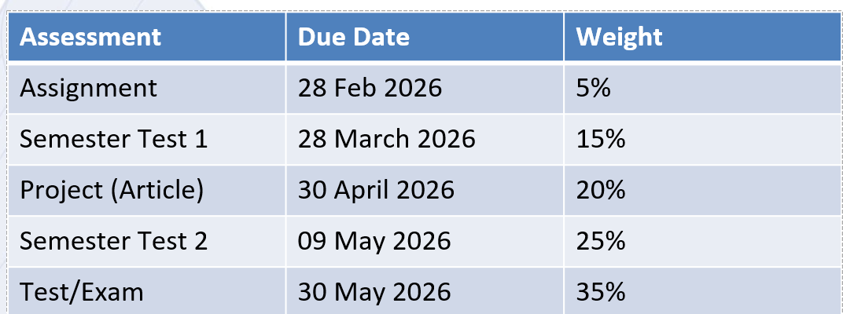
Assessments (Continuous)

Slide 5
Intelligent Agents
What is an agent ?
An agent is anything that perceives its environment through sensors and acting upon that environment through actuators
Example:
Human is an agent
A robot is also an agent with cameras and motors
A thermostat detecting room temperature.

Slide 6
What is an Agent?
The main point about agents is they are autonomous: capable of acting independently, exhibiting control over their internal state
Thus: an agent is a computer system capable of autonomous action in some environment to meet its design objectives
SYSTEM
input
output
ENVIRONMENT

Slide 7
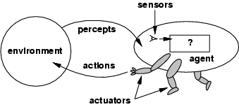
Agents
An agent perceives its environment via sensors and acts upon that environment through its actuators

Slide 8
Intelligent Agents
Agents are comprised of an architecture (e.g. a computer) plus a program that runs on that architecture.
In designing intelligent systems there are four main factors to consider:
P Percepts – the inputs to our system
A Actions – the outputs of our system
G Goals – what the agent is expected to achieve
E Environment – what the agent is interacting with

Slide 9
Intelligent Agents
An intelligent agent is one that is capable of flexible autonomous action to meet its design objectives
Flexible:
Reactivity: perceive and respond in timely fashion
Pro-activeness: goal-directed behavior by taking the initiative to achieve the goal
Social ability: interaction and communication

Slide 10
Dear child gets many names…
Many synonyms of the term “Intelligent agent”
Robots
Software agent or softbots
Knowbots
Taskbots
Userbots
……

Slide 11
Other Properties
Other properties, sometimes discussed in the context of agency:
mobility: the ability of an agent to move around an electronic network
veracity: an agent will not knowingly communicate false information
benevolence: agents do not have conflicting goals, and that every agent will therefore always try to do what is asked of it
rationality: agent will act in order to achieve its goals, and will not act in such a way as to prevent its goals being achieved — at least insofar as its beliefs permit
learning/adaption: agents improve performance over time

Slide 12
Concept of Rationality
Rational agent
One that does the right thing
● = every entry in the table for the agent function is correct (rational).
What is correct?
The actions that cause the agent to be most successful
So we need ways to measure success.

Slide 13
Rational agent…
An agent should strive to "do the right thing", based on what:
it can perceive and
the actions it can perform.
The right action is the one that will cause the agent to be most successful

Slide 14
Rationality…
What is rational at any given time depends on four things:
The performance measure defining the criterion of success
The agent’s prior knowledge of the environment
The actions that the agent can perform
The agents’s percept sequence up to now

Slide 15
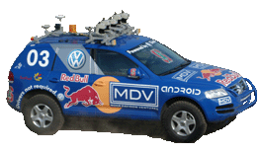
Rationality
Must first specify the setting for intelligent agent design.
PEAS: Performance measure, Environment, Actuators, Sensors Example: the task of designing a self-driving car
– Performance measure
Safe, fast, legal, comfortable trip
– Environment
Roads, other traffic, pedestrians
– Actuators
Steering wheel, accelerator, brake, signal, horn
– Sensors
Cameras, LIDAR (light/radar), speedometer, GPS, odometer engine sensors, keyboard

Slide 16
PAGE Descriptors vs. PEAS Descriptors
PAGE Descriptors are not the unique way of describing intelligent systems. One popular alternative involves PEAS Descriptors:
P Performance – how we measure the system’s achievements E Environment – what the agent is interacting with
A Actuators – what produces the outputs of the system S Sensors – what provides the inputs to the system
We can see that there is a clear and simple mapping between PAGE and PEAS:
Performance
Environment Actuators Sensors
Pecepts
Actions Goals Environment
Which descriptors we use makes little difference to the systems we build.

Slide 17
Rational agents
Rational Agent: For each possible percept sequence, a rational agent should select an action that is expected to maximize its performance measure, given the evidence provided by the percept sequence and whatever built-in knowledge the agent has.

Slide 18
Reactivity
If a program’s environment is guaranteed to be fixed, the program need never worry about its own success or failure – program just executes blindly
Example of fixed environment: compiler
The real world is not like that: things change, information is incomplete. Many (most?) interesting environments are dynamic
Software is hard to build for dynamic domains: program must take into account possibility of failure – ask itself whether it is worth executing!
A reactive system is one that maintains an ongoing interaction with its environment, and responds to changes that occur in it (in time for the response to be useful)

Slide 19
Proactiveness
Reacting to an environment is easy (e.g., stimulus → response rules)
But we generally want agents to do things for us
Hence goal directed behavior
Pro-activeness = generating and attempting to achieve goals; not driven solely by events; taking the initiative
Recognizing opportunities

Slide 20
Balancing Reactive and Goal-Oriented Behavior
We want our agents to be reactive, responding to changing conditions in an appropriate (timely) fashion
We want our agents to systematically work towards long-term goals
These two considerations can be at odds with one another
Designing an agent that can balance the two remains an open research problem

Slide 21
Social Ability
The real world is a multi-agent environment: we cannot go around attempting to achieve goals without taking others into account
Some goals can only be achieved with the cooperation of others
Similarly for many computer environments: witness the Internet
Social ability in agents is the ability to interact with other agents (and possibly humans) via some kind of agent-communication language, and perhaps cooperate with others

Slide 22
Autonomy
If an agent just relies on the prior knowledge of its designer rather than its own percepts then the agent lacks autonomy
A rational agent should be autonomous- it should learn what it can to compensate for partial or incorrect prior knowledge.
E.g., a clock
No input (percepts)
Run only but its own algorithm (prior knowledge)
No learning, no experience, etc.

Slide 23
Examples of agents
Agent type
Percepts
Actions
Goals
Environment
Medical diagnosis system
Symptoms, findings, patient's answers
Questions, tests, treatments
Healthy patients, minimize costs
Patient, hospital
Satellite image analysis system
Pixels of varying intensity, color
Print a categorization of scene
Correct categorization
Images from orbiting satellite
Part-picking robot
Pixels of varying intensity
Pick up parts and sort into bins
Place parts in correct bins
Conveyor belts with parts
Refinery controller
Temperature, pressure readings
Open, close valves; adjust temperature
Maximize purity, yield, safety
Refinery
Interactive English tutor
Typed words
Print exercises, suggestions, corrections
Maximize student's score on test
Set of students

Slide 24
Agent types
Four basic types in order of increasing generality:
Simple reflex agents
Model-based reflex agents
Goal-based agents
Utility-based agents

Slide 25
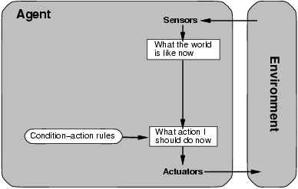
Simple reflex agents

Slide 26
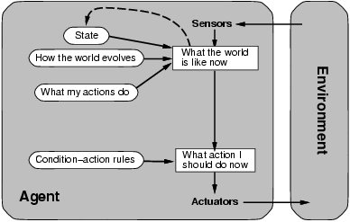
Model-based reflex agents

Slide 27
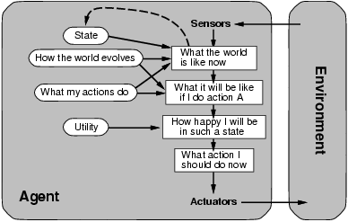
Utility-based agents

Slide 28
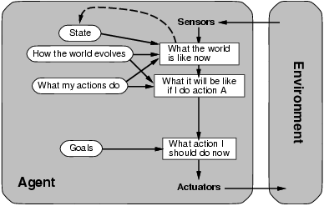
Goal-based agents

Slide 29
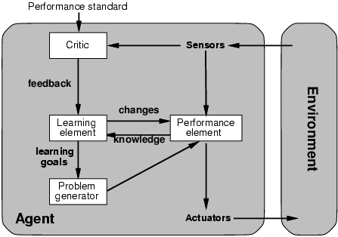
Learning agents

Slide 30
Simple reflex agents…
It uses just condition-action rules
The rules are like the form “if … then …”
efficient but have narrow range of applicability
Because knowledge sometimes cannot be stated explicitly
Work only
if the environment is fully observable

Slide 31
Reflex Agents with State
For the world that is partially observable
the agent has to keep track of an internal state
That depends on the percept history
Reflecting some of the unobserved aspects
E.g., driving a car and changing lane
Requiring two types of knowledge
How the world evolves independently of the agent
How the agent’s actions affect the world

Slide 32
Reflex Agents with State…
Reflex agent with state
Incorporates a model of the world
Current state of its world depends on percept history
Rule to be applied next depends on resulting state
state’ ← next-state( state, percept ) action ← select-action( state’, rules )

Slide 33
Example Table Agent
With Internal State
IF THEN
Saw an object ahead, and turned right, and it’s now clear ahead | Go straight
Saw an object Ahead, turned right, and object ahead again | Halt
See no objects ahead | Go straight
See an object ahead | Turn randomly

Slide 34
Goal-based agents
Current state of the environment is always not enough
The goal is another issue to achieve
Judgment of rationality / correctness
Actions chosen → goals, based on
the current state
the current percept

Slide 35
Incorporating Goals
Rules and “foresight”
Essentially, the agent’s rule set is determined by its goals
Requires knowledge of future consequences given possible actions
Can also be viewed as an agent with more complex state management
Goals provide for a more sophisticated next-state function

Slide 36



Utility-based agents
Goals alone are not enough
to generate high-quality behavior
E.g. meals in Canteen, good or not ?
Many action sequences → the goals
some are better and some worse
If goal means success,
then utility means the degree of success (how successful it is)

Slide 37
Utility-based agents…
Utility has several advantages:
When there are conflicting goals,
Only some of the goals but not all can be achieved
utility describes the appropriate trade-off
When there are several goals
None of them are achieved certainly
utility provides a way for the decision-making

Slide 38
Incorporating Performance
May have multiple action sequences that arrive at a goal
Choose action that provides the best level of “happiness” for the agent
Utility function maps states to a measure
May include tradeoffs
May incorporate likelihood measures

Slide 39
Learning Agents…
After an agent is programmed, can it work immediately?
No, it still need teaching
In AI,
Once an agent is done we teach it by giving it a set of examples
Test it by using another set of examples
We then say the agent learns
A learning agent

Slide 40
Goal Based Agents
Even with the increased knowledge of the current state of the world provided by an agent’s internal state, the agent may still not have enough information to tell it what to do. The appropriate action for the agent will often depend on what its goals are, and so it must be provided with some goal information.
Given knowledge of how the world evolves, and of how its own actions will affect its state, an agent will be able to determine the consequences of all (or many) possible actions. It can then compare each of these against its goal to determine which action(s) achieves its goal, and hence which action(s) to take.
If a long sequence of actions is required to reach the goal, then Search and Planning are the sub-fields of AI that must be called into action. In simple reflex agents, such information would have to be pre-computed and built into the system by the designer.
Goal based agents may appear less efficient, but they are far more flexible. We can simply specify a new goal, rather than re-programming all the rules.

Slide 41
Utility Based Agents
Goals alone are not enough to generate high quality behaviour. Often there are many sequences of actions that can result in the same goal being achieved. Given appropriate criteria, it may be possible to chose the ‘best’ sequence of actions from a number that all result in the goal being achieved.
We talk about the utility of particular states. Any utility based agent can be described as possessing a utility function that maps a state, or sequence of states, on to a real number that represents its utility or usefulness.
We can then use the utility to choose between alternative sequences of actions/states that lead to a given goal being achieved.
When there are conflicting goals, only some of which can be achieved, the utility is able to quantify the appropriate trade-offs.
When there are several goals, none of which can be achieved with certainty, the utility allows the likeliness of success to be weighed up against the importance of the goals.

Slide 42
Machine Learning
We can see that percepts should not only be used for generating an agent’s immediate actions, but also for improving its ability to act in the future, i.e. for learning.
In practice, learning can correspond to anything from trivial memorisation, to the creation of complete scientific theories.
We conventionally classify learning into three increasingly difficult classes:
Supervised Learning – learning with a teacher (e.g. the system is told what outputs it should produce for each of a set of inputs)
Reinforcement learning – learning with limited feedback (e.g. the system must produce outputs for a set of inputs and is only told whether they are good or bad)
Unsupervised learning – learning with no help (e.g. the system is given a set of inputs and is expected to make some kind of sense of them on its own)
Machine learning systems can be set up to do all three types of learning.

Slide 43
Learning Agents
The most powerful agents are able to learn by actively exploring and experimenting with their environment.
A general learning agent has four basic components:
The Performance Element – which takes in percepts and decides on appropriate actions in the same way as a non-learning agent.
The Critic – which uses a fixed standard of performance to tell the learning element how well the agent is doing.
The Learning Element – that receives information from the critic and makes appropriate improvements to the performance element.
The Problem Generator – that suggests actions that will lead to new and informative experiences (e.g. as in carrying out experiments).
Note that not all learning agents will need a problem generator – a teacher, or the agent’s normal mode of operation, may provide sufficient feedback for learning.

Slide 44
The Agent Environments
We have talked a lot about intelligent agents, but little about the environments with which they interact. There are five particularly useful dimensions along which one can categorize the properties of an agent’s environment:
Accessible vs. Inaccessible – An environment is accessible to an agent if the agent’s sensory apparatus gives it access to the complete state of the environment. The agent will not then need to maintain an internal state to keep track of the world.
Deterministic vs. Non-deterministic – The environment is deterministic if its next state is determined completely by its current state and the actions of its agents. A deterministic but inaccessible environment may appear non-deterministic to the agent. Most real environments are so complex that, in practice, they have to be treated as non-deterministic.
Discrete vs. Continuous – A discrete environment has a limited/finite number of distinct, clearly defined percepts and actions.

Slide 45
Episodic vs. Non-episodic – In an episodic environment the agent’s experience can be divided into “episodes” consisting of the agent perceiving and then producing actions that depend only on that episode. Subsequent episodes do not depend on previous episodes, and so the agent can limit how far it needs to think ahead.
Static vs. Dynamic – A static environment does not change while an agent is deliberating. The agent will then have no need to keep checking the world while it is deciding on an action, nor worry about the passage of time.
It is clear that different types of environment will require different types of agents to deal with them effectively.
The hardest environments to cope with will be inaccessible, non-deterministic, continuous, non-episodic, and dynamic.
Often we run an environment program for our agents to interact with. This gives each agent its percepts, receives an action from each agent, and then updates the environment. It may also keep track of the performance measures for each agent.

Slide 46
How to design an intelligent agent?
Definition: An agent perceives its environment via sensors and acts in that environment with its effectors.
Hence, an agent gets percepts one at a time, and maps this percept sequence to actions (one action at a time)
Properties:
Autonomous
Interacts with other agents plus the environment
Reactive to the environment
Pro-active (goal-directed)

Slide 47
Properties of environments
Accessible (observable) : The agent’s sensory apparatus gives it access to the complete state of the environment
Deterministic: The next state of the environment is completely determined by the current state and the actions selected by the agent
Subjective non-determinism
- Limited memory (poker)
- Too complex environment to model directly (weather, dice)
- Inaccessibility
Episodic: The agent’s experience is divided into independent “episodes,” each episode consisting of agent perceiving and then acting. Quality of action depends just on the episode itself, because subsequent episodes do not depend on what actions occur in previous episodes. → Do not need to think ahead

Slide 48
Properties of environments …
Static: If the environment can change while the agent is deliberating, then the environment is dynamic; otherwise it’s static.
Discrete: There are a limited number of distinct, clearly defined percepts and actions we say that environment is discrete.
Need to worry about time
Dynamic
Need to observe while deliberating

Slide 49
Type of environment
An agent will not have complete control over its environment, but have partial control, in that it can influence it.
Classification of environment properties
Accessible vs. inaccessible
Deterministic vs. non-deterministic
Episodic vs. non-episodic
Static vs. dynamic
Discrete vs. continuous

Slide 50
Accessible vs. inaccessible
Accessible vs. inaccessible
An accessible environment is one in which the agent can obtain complete, accurate, up-to-date information about the environment’s state. (also complete observable vs. partial observable)
Accessible: sensor give complete state of the environment.
In an accessible environment, agent needn’t keep track of the world through its internal state.

Slide 51
Deterministic vs. non-deterministic
Deterministic vs. non-deterministic
A deterministic environment is one in which any action has a single guaranteed effect , there is no uncertainty about the state that will result from performing an action.
That is, next state of the environment is completely determined by the current state and the action select by the agent.
Non-deterministic: a probabilistic model could be available.

Slide 52
Episodic vs. non-episodic
Episodic vs. non-episodic
In an episodic environment, the performance of an agent is dependent on a number of discrete episodes, with no link between the performance of an agent in different scenarios. It need not reason about the interaction between this and future episodes. (such as a game of chess)
In an episodic environment, agent doesn’t need to remember the past, and doesn’t have to think the next episodic ahead.
Notes:
Everything it needs to know is the current state’s percept.

Slide 53
Static vs. dynamic
Static vs. dynamic
A static environment is one that can assumed to remain unchanged expect by the performance of actions by the agents.
A dynamic environment is one that has other processes operating on it which hence changes in ways beyond the agent’s control.

Slide 54
Discrete vs. continuous
Discrete vs. continuous
An environment is discrete if there are a fixed, finite number of actions and percepts in it.

Slide 55
Foundations of AI
Philosophy: logic, mind, knowledge
Mathematics: proof, computability, probability
Economics: maximizing payoffs
Neuroscience: brain and neurons
Psychology: thought, perception, action
Control Theory: stable feedback systems
Linguistics: knowledge representation, syntax

Slide 56
Learning Agents
After an agent is programmed, can it work immediately?
No, it still needs teaching
In AI,
Once an agent is done
We teach it by giving it a set of examples
Test it by using another set of examples
We then say the agent learns
A learning agent

Slide 57
Software Agents
Sometimes, the environment may not be the real world
E.g., flight simulator, video games, Internet
They are all artificial but very complex environments
Those agents working in these environments are called
Software agent (softbots)
Because all parts of the agent are software

Slide 58
Properties of task environments…
Single agent VS. multiagent
Playing a crossword puzzle – single agent
Chess playing – two agents
Competitive multiagent environment
Chess playing
Cooperative multiagent environment
Automated taxi driver
Avoiding collision

Slide 59
Properties of task environments…
Known vs. unknown
This distinction refers not to the environment itself but to the agent’s (or designer’s) state of knowledge about the environment.
-In known environment, the outcomes for all actions are given. (example: solitaire card games).
- If the environment is unknown, the agent will have to learn how it works in order to make good decisions.(example: new video game).

Slide 60

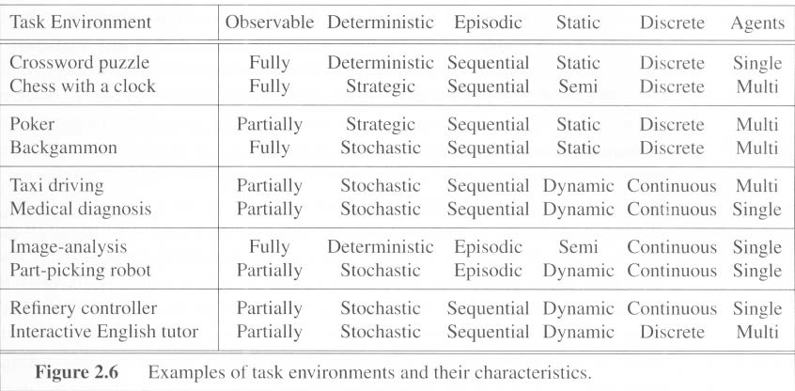
Examples of task environments…

Slide 61
Summary: agent types
(1) Simple reflex agents
are based on condition-action rules, implemented with an appropriate production system. They are stateless devices which do not have memory of past world states.
(2) Agents with memory - Model-based reflex agents
have internal state, which is used to keep track of past states of the world.
(3) Agents with goals – Goal-based agents
are agents that, in addition to state information, have goal information that describes desirable situations. Agents of this kind take future events into consideration.
(4) Utility-based agents
base their decisions on classic axiomatic utility theory in order to act rationally.
(5) Learning agents
they have the ability to improve performance through learning.

Slide 62
Summary
An agent perceives and acts in an environment, has an architecture, and is implemented by an agent program.
A rational agent always chooses the action which maximizes its expected performance, given its percept sequence so far.
An autonomous agent uses its own experience rather than built-in knowledge of the environment by the designer.
An agent program maps from percept to action and updates its internal state.
Reflex agents (simple / model-based) respond immediately to percepts.
Goal-based agents act in order to achieve their goal(s), possible sequence of steps.
Utility-based agents maximize their own utility function.
Learning agents improve their performance through learning.
Representing knowledge is important for successful agent design.
•
The most challenging environments are partially observable, stochastic, sequential, dynamic, and continuous, and contain multiple intelligent agents.

Slide 63
Summary
An agent perceives and acts in an environment, has an architecture, and is implemented by an agent program.
A rational agent always chooses the action which maximizes its expected performance, given its percept sequence so far.
An autonomous agent uses its own experience rather than built-in knowledge of the environment by the designer.
An agent program maps from percept to action and updates its internal state.
Reflex agents (simple / model-based) respond immediately to percepts.
Goal-based agents act in order to achieve their goal(s), possible sequence of steps.
Utility-based agents maximize their own utility function.
Learning agents improve their performance through learning.
Representing knowledge is important for successful agent design.
The most challenging environments are partially observable, stochastic, sequential, dynamic, and continuous, and contain multiple intelligent agents.

Slide 64

THANK YOU

